Slide 1
Graphical User Interface and Data Handling in for a Nuclear Quadrupole Resonance Software Defined Radio Spectrometer
WISSEN
TECHNIK
LEIDENSCHAFT
Notes:
Hello everybody,
Welcome to my Presentation of Graphical User Interface and Data Handling in for a Nuclear Quadrupole Resonance Software Defined Radio Spectrometer

Slide 2
Content:
Introduction
Method
Results
Future work
Conclusion and Q & A

Slide 3
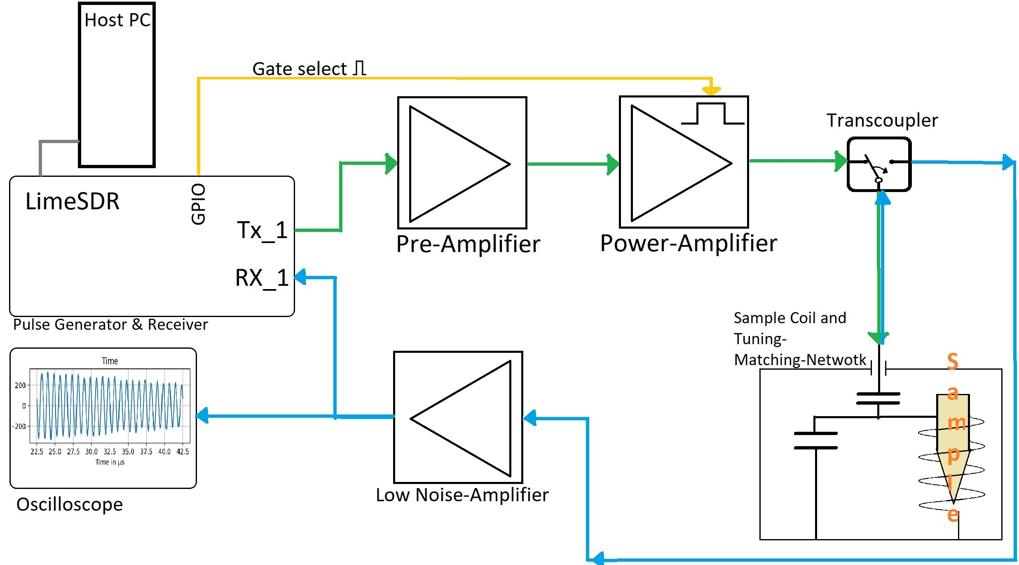
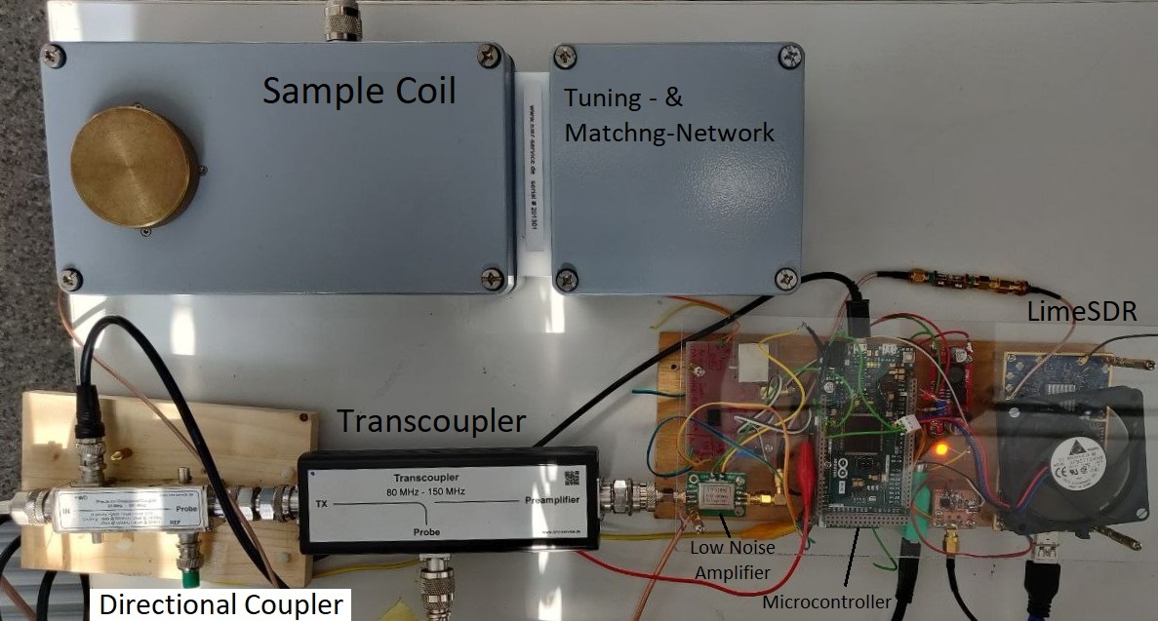
Introduktion:
Hardware setup
Signal-flow path
Notes:
The Introduction:
This is how the setup was finalised and represents a single frequency manual tuning and matching setup. It starts with the Host PC and the LimeSDR. (seen in the top left coner)
wearable electronics for example watches or smartphones that monitors the body are olread in day to day use. With its new Technology like recording the hart rate , blood oxygenation or ECG functions it can be helpful, for Doctors to diagnostic later. It is to be noted, their risks and side effects of such devices do not substitute Professional Equipment for its diagnosis.
Nowadays with the help of the miniaturization we are able to bring all this named, once large sensor not only onto our wrist but direct to and under the skin with new tissue compatible materials. Soft electronics allows with maximum user comfort, continuous real-time data collection of bio-signals.

Slide 4
Method :
Github.com/oe9nat/ba
Tissue compatible materials
Notes:
The Introduction: wearable electronics for example watches or smartphones that monitors the body are olread in day to day use. With its new Technology like recording the hart rate , blood oxygenation or ECG functions it can be helpful, for Doctors to diagnostic later. It is to be noted, their risks and side effects of such devices do not substitute Professional Equipment for its diagnosis.
Nowadays with the help of the miniaturization we are able to bring all this named, once large sensor not only onto our wrist but direct to and under the skin with new tissue compatible materials. Soft electronics allows with maximum user comfort, continuous real-time data collection of bio-signals.

Slide 5
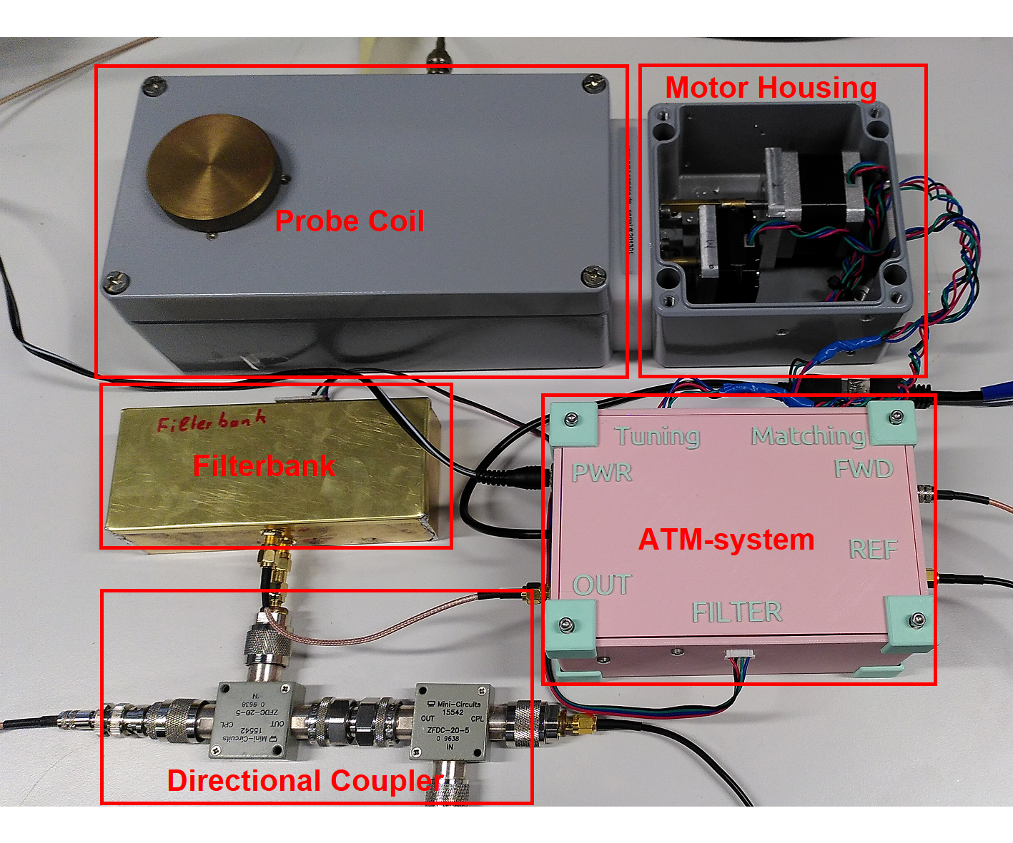
Future work:
Wearable electronics
Tissue compatible materials
work:
Julia Pitzer; https://github.com/jupfi/ATM
Notes:
The Introduction: wearable electronics for example watches or smartphones that monitors the body are olread in day to day use. With its new Technology like recording the hart rate , blood oxygenation or ECG functions it can be helpful, for Doctors to diagnostic later. It is to be noted, their risks and side effects of such devices do not substitute Professional Equipment for its diagnosis.
Nowadays with the help of the miniaturization we are able to bring all this named, once large sensor not only onto our wrist but direct to and under the skin with new tissue compatible materials. Soft electronics allows with maximum user comfort, continuous real-time data collection of bio-signals.

Slide 6
Results :
Wearable electronics
Tissue compatible materials
Notes:
The Introduction: wearable electronics for example watches or smartphones that monitors the body are olread in day to day use. With its new Technology like recording the hart rate , blood oxygenation or ECG functions it can be helpful, for Doctors to diagnostic later. It is to be noted, their risks and side effects of such devices do not substitute Professional Equipment for its diagnosis.
Nowadays with the help of the miniaturization we are able to bring all this named, once large sensor not only onto our wrist but direct to and under the skin with new tissue compatible materials. Soft electronics allows with maximum user comfort, continuous real-time data collection of bio-signals.

Slide 7
Results :
Wearable electronics
Tissue compatible materials
Notes:
The Introduction: wearable electronics for example watches or smartphones that monitors the body are olread in day to day use. With its new Technology like recording the hart rate , blood oxygenation or ECG functions it can be helpful, for Doctors to diagnostic later. It is to be noted, their risks and side effects of such devices do not substitute Professional Equipment for its diagnosis.
Nowadays with the help of the miniaturization we are able to bring all this named, once large sensor not only onto our wrist but direct to and under the skin with new tissue compatible materials. Soft electronics allows with maximum user comfort, continuous real-time data collection of bio-signals.

Slide 8

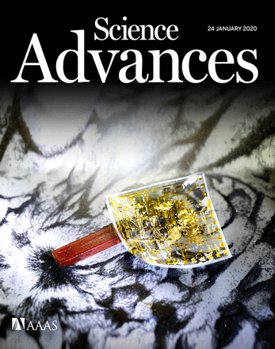
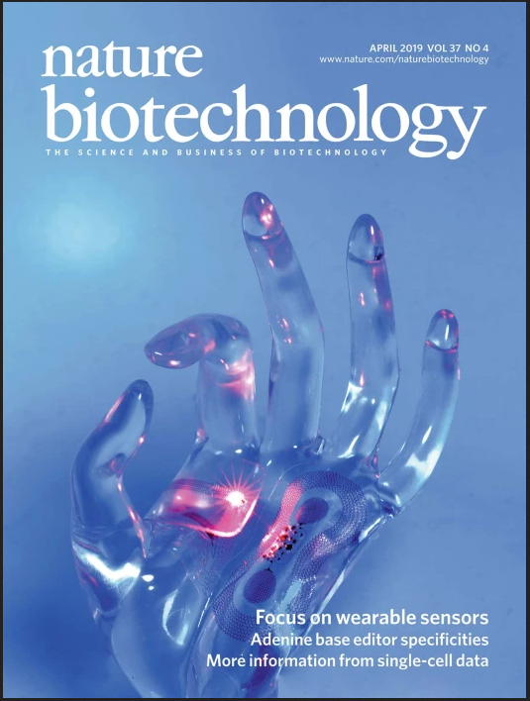
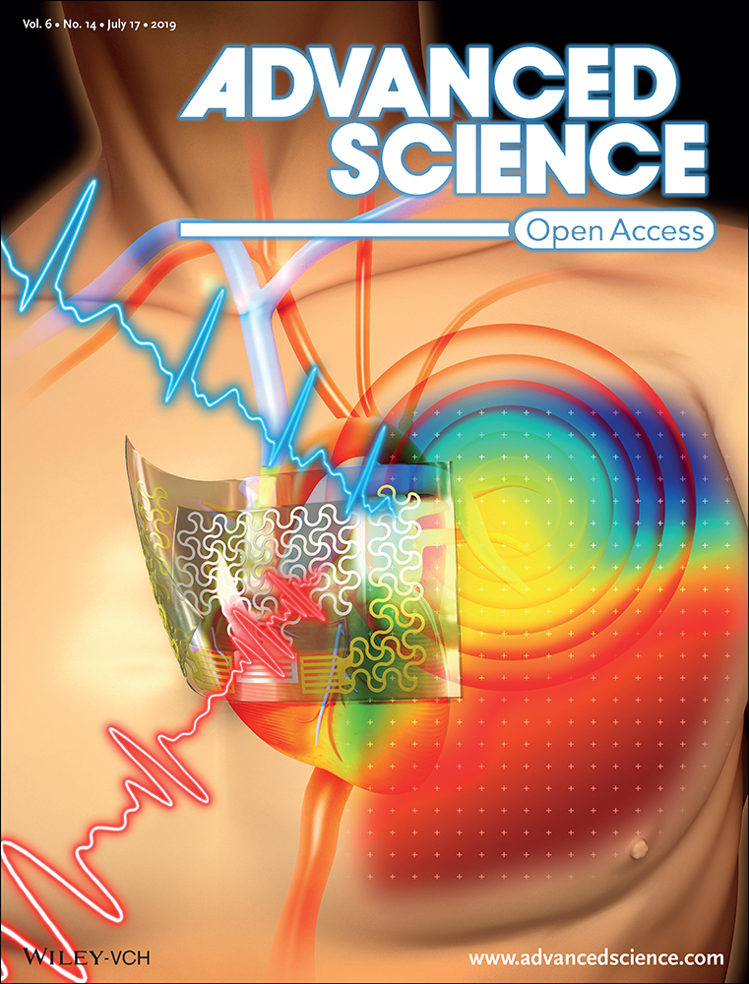
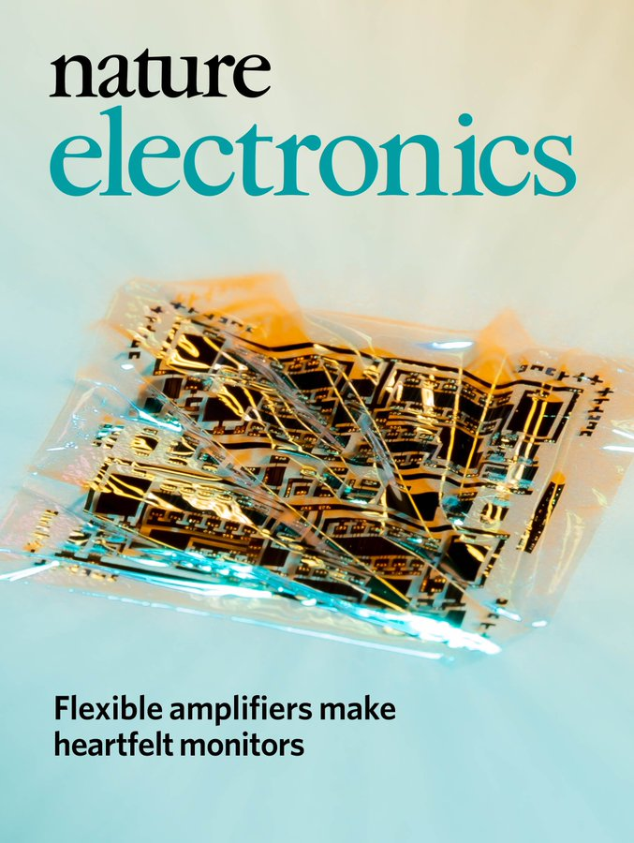
Methods & Data Collection
Field of interest
Publication not older than 24 Month
Well- respected Jurnals
Notes:
Methods and Data Collection Main proportion of the information was taken from well-known journals in its specific area, which were published in the last 24 month. As this paper shall represent the state of the art, few references can be older if there are no newer inovations found.

Slide 9
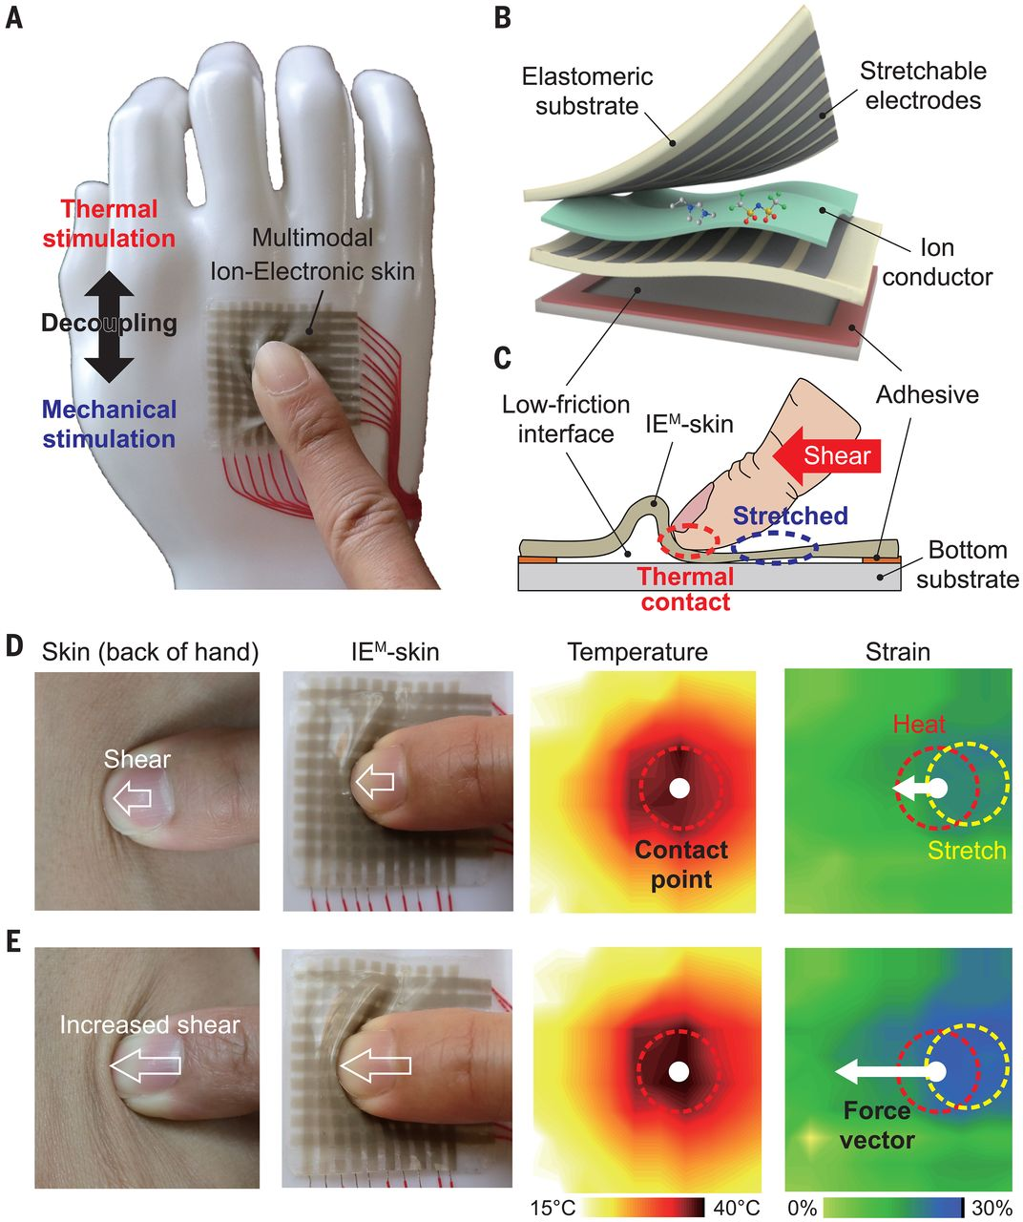
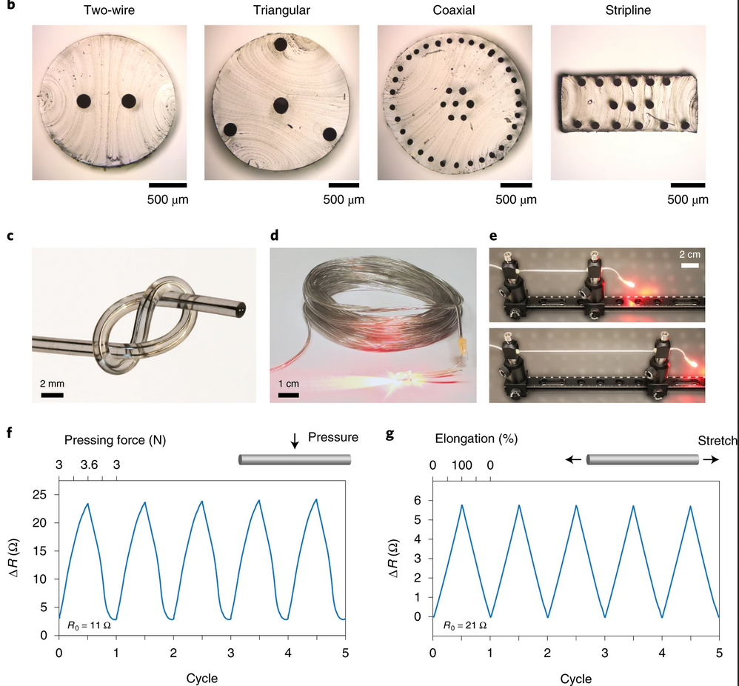
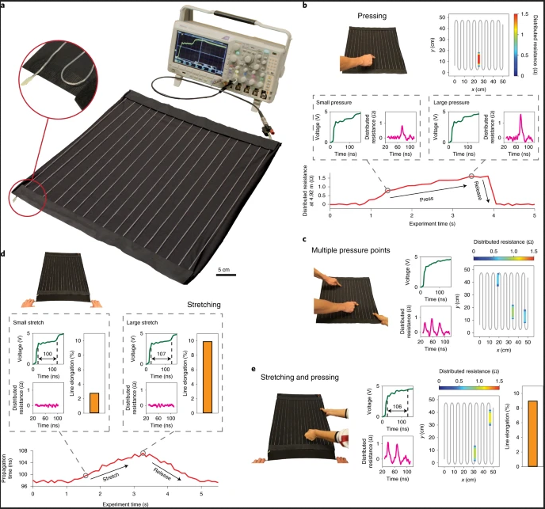
Results: smart textiles
Science (2020). DOI: 10.1126/science.aba5132
Nature Electron 3, 316–326 (2020). DOI: 10.1038/s41928-020-0415-y
Notes:
Smart textiles
Bringing together Cost-effective and multi sensing threads, have a wide range of application. As representative sown hear, the soft and strechable pad on the left side, or the wire on the right side, is able to sence pressure and strech Deformation. Bioelectic sensor on the basis of textile serve a significant step for a compact, lightweight and easy to wear platform for real time monitoring.

Slide 10
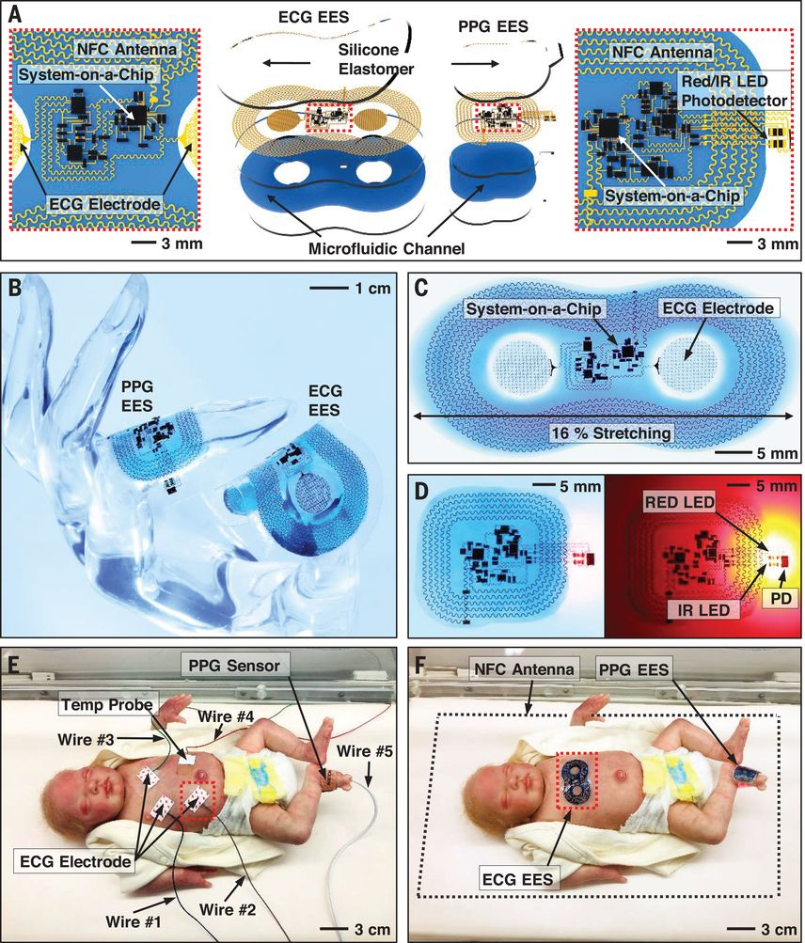
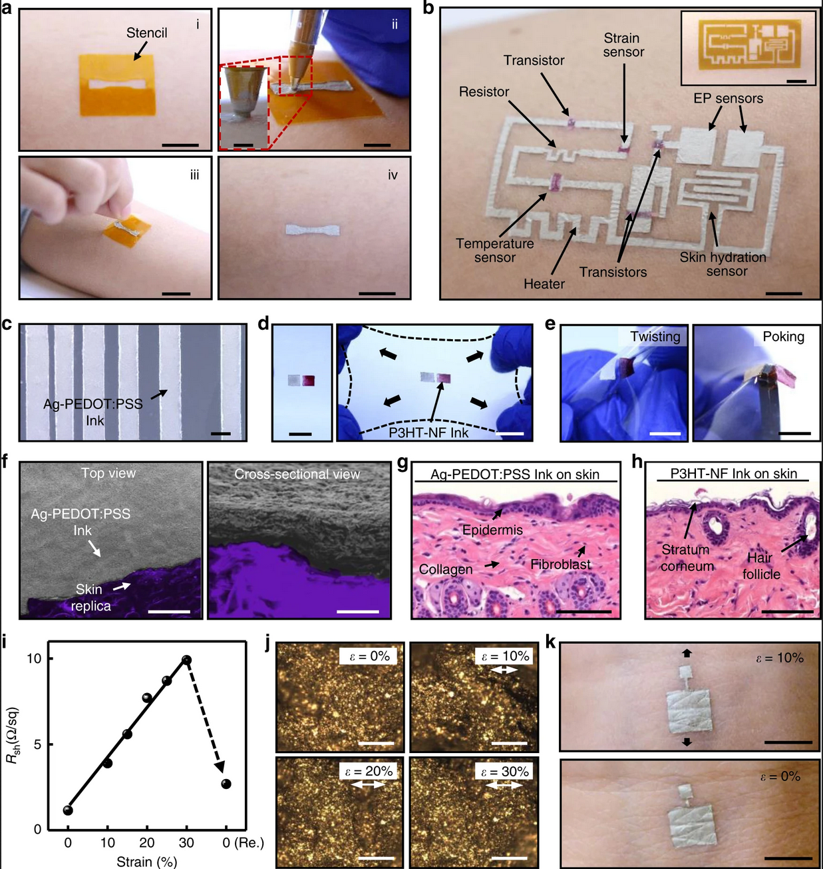
Skin sensors
Science (2019) Vol. 363, DOI: 10.1126/science.aau0780
Nature Commun 11, 3823 (2020). DOI: 10.1038/s41467-020-17619-1
Notes:
Skin sensors:
With skin-like patches which house wireless near-field communication (NFC) and medical grad sensor, continues monitoring without limitation of cables can be achieved. As these devices are all on soft substrates they can be easily reshaped. The effects of deformation can detune the Antenna and therefore reduce or block the efficiency of the transmission.
Direct drawing the sensor to the skin can reduce artifact. The Signal collection or stimulation area is therefore uninfluenced regardless of movement.

Slide 11
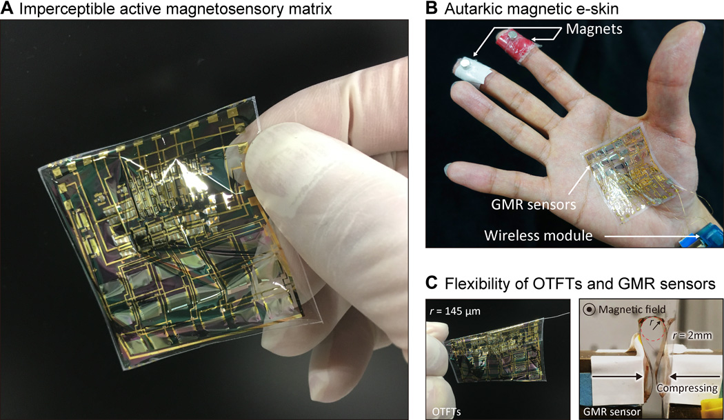
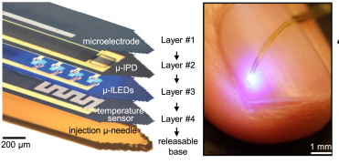
Application
ScienceDirect (2015) DOI: 10.1016/j.neuron.2014.12.035
Science Advances (2020) DOI: 10.1126/sciadv.aay6094
Notes:
Dependent on the Application different Sensors and Materials have to be used. With fully integrated optoelectronic sensors, penetrating neural probes can be manufactured.
As seen on the right, with a flexible matrix sensors the user can get a sentation of the magnetic field.

Slide 12
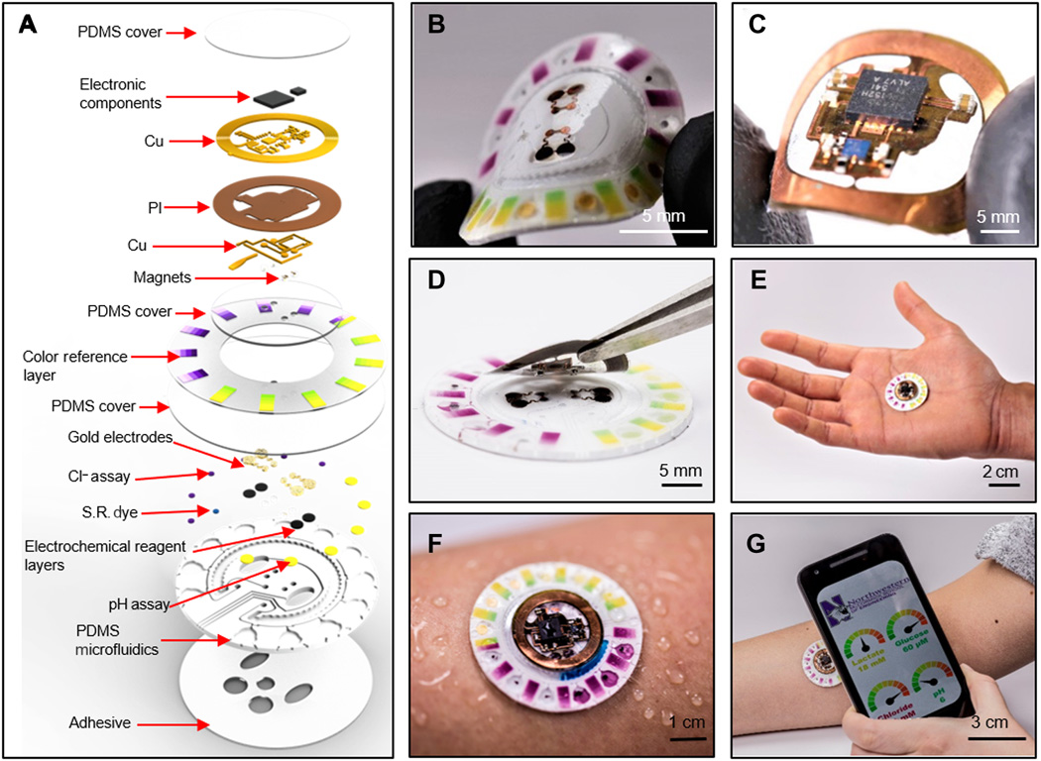
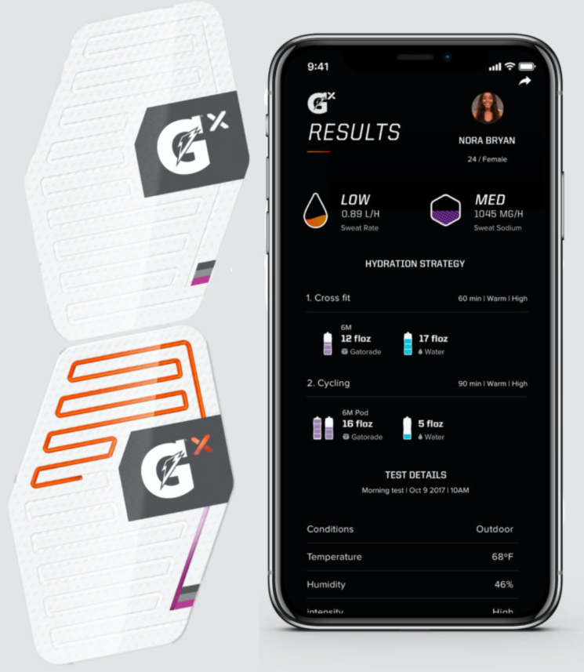
Lab on a chip Technology
Science Advances 18 Jan 2019: DOI: 10.1126/sciadv.aav3294
Gx Swaet patch from Gatorade, release fall of 2019
Notes:
With biosensors and microfluidic structures sweat rate, pH level, lactate, glucose, and chloride can be directly collected form the skin for analysing in real time. With noninvasive semi-quantitative tracking, brings us another source for a better understanding in what physiological state the body is.
Sweat testing products are already available for hobby and professional athletes. Like seen on the right side the Gx sweat patch from Gatoradeto. The patch can track fluid loss and analyze sweat sodium content. It presents the athlete what has been lost during the training for planning his rehydration afterwards.

Slide 13
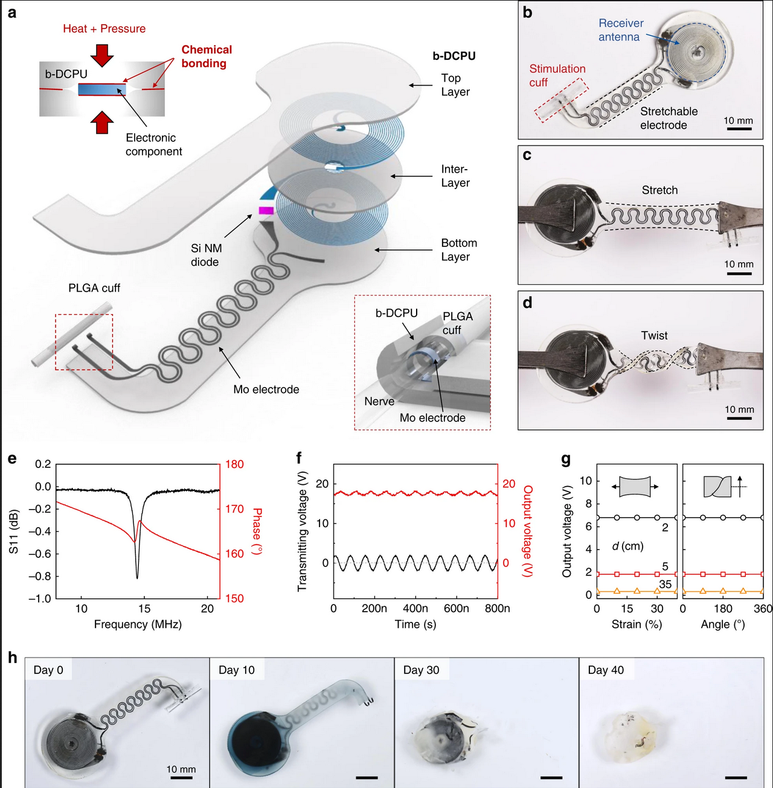
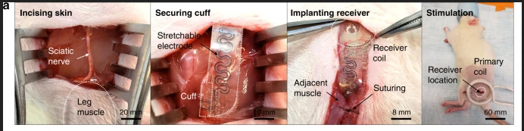
Conclusion
Thank you for your attention!
Application for Hospital
Intensive care
Diagnostic
Use for Sportman
Nature Commun 11, 5990 (2020). DOI:10.1038/s41467-020-19660-6
Notes:
It can be seen, currently developed products are highly specialized to its application. With the continuous rising customer demand the development has been pushed into selective regions of applications.
The Hospitals demands highly specialized appllication. On the other hand Sportman deman easy to use Gadget.
In the Future we will see more, soft electronics which have integrated sensors witch transfer vital Information to the user over wireless networks. With direct energy harvesting they can be operated almost endlessly. Now Uncurable injury like paraplegia will have the possibility to get cured. Long term stimulation implanted electrodes will be available and after its expiry date they will be reabsorbed and therefor eliminates the risks from explantation. Thank you for your attention For any Question feel free to ask them now

